Slide 1
Location Planning and Analysis

Slide 2
Need for Location Decisions
Marketing Strategy
Cost of Doing Business
Growth
Depletion of Resources

Slide 3
Strategic Importance of location decisions
Location decisions are closely related to an organization’s strategies.
Eg.- low cost producer will locate near market of raw material
Strategy of increasing profits by increasing market share may result in high-traffic areas.
Strategy for convenience to customers may result in many locations where customers can make purchases.

Slide 4
Nature of Location Decisions
Strategic Importance of location decisions
Long term commitment/costs
Impact on investments, revenues, and operations
Supply chains
Objectives of location decisions
Profit potential
No single location may be better than others
Identify several locations from which to choose
Location critieria may depend upon where a business is in the supply chain.
Location Options
Expand existing facilities
Add new facilities
Move
Doing nothing

Slide 5
Making Location Decisions
Decide on the criteria
Identify the important factors
Develop location alternatives
Evaluate the alternatives
Identify general region
Identify a small number of community alternatives
Identify site alternatives
Evaluate and make selection

Slide 6
Location Decision Factors
Community Considerations
Regional Factors
Multiple Plant Strategies
Site-related Factors

Slide 7
Regional Factors
Location of raw materials
Location of markets
Labor factors
Climate and taxes

Slide 8
Community Considerations
Quality of life
Services
Attitudes
Environmental regulations
Utilities
Developer support

Slide 9
Site Related Factors
Land
Transportation
Environmental
Legal

Slide 10
Evaluating Locations
Cost-Profit-Volume Analysis
Determine fixed and variable costs
Plot total costs
Determine lowest total costs

Slide 11
Location Cost-Volume Analysis
Assumptions
Fixed costs are constant
Variable costs are linear
Output can be closely estimated
Only one product involved

Slide 12
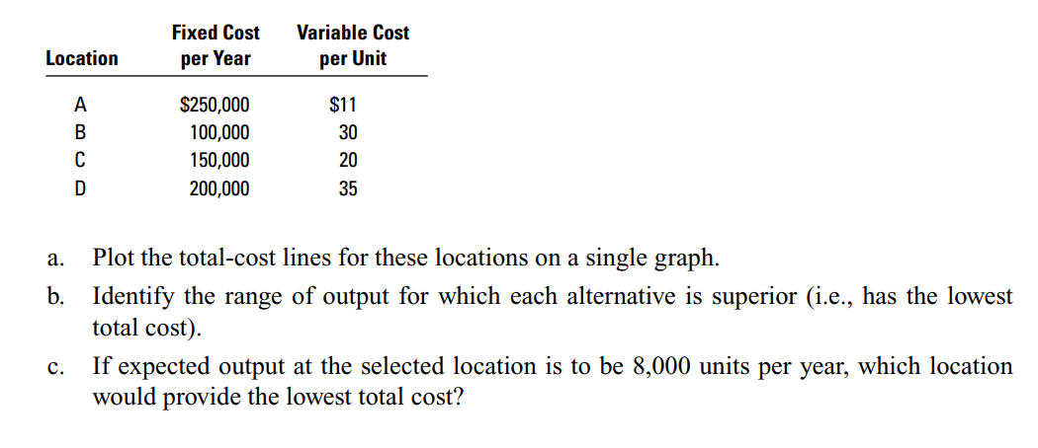
EXAMPLE

Slide 13
Example 1: Cost-Volume Analysis
Fixed and variable costs for four potential locations

Slide 14
Example 1: Solution

Slide 15
Example 1: Solution
$(000)
800
700
600
500
400
300
200
100
0
D
B
C
A
A Superior
C Superior
B Superior
0
2
4
6
8
10
12
14
16
Annual Output (000)

Slide 16
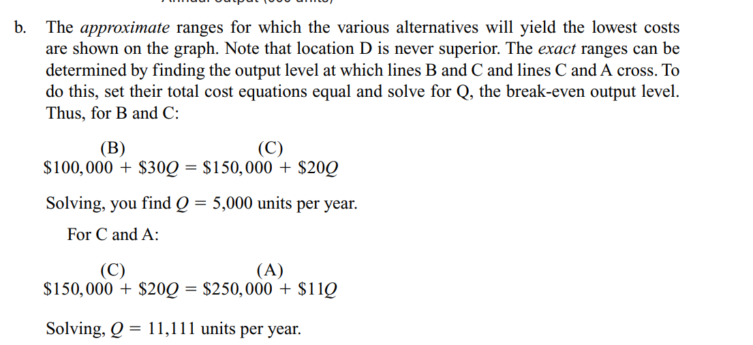
Solution

Slide 17
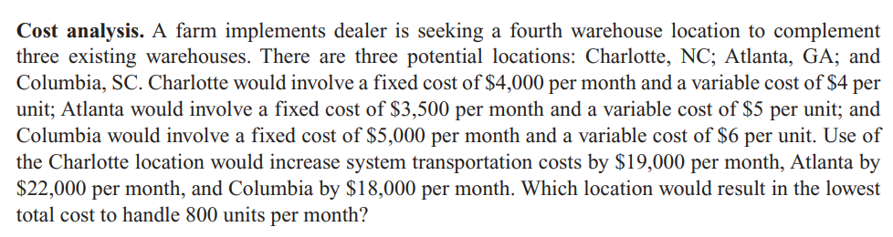
Example 2

Slide 18
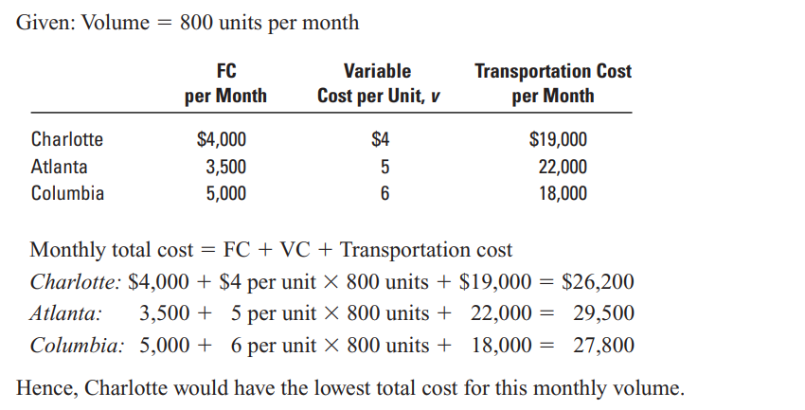
Solution

Slide 19
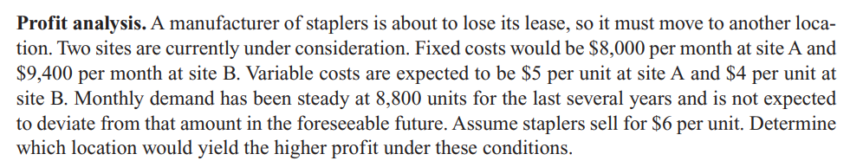
Example 3

Slide 20
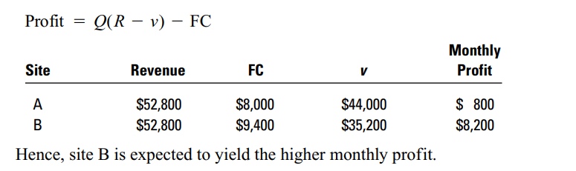
Solution

Slide 21
Evaluating Locations
Transportation Model
Decision based on movement costs of raw materials or finished goods
Factor Rating
Decision based on quantitative and qualitative inputs
Center of Gravity Method
Decision based on minimum distribution costs

Slide 22
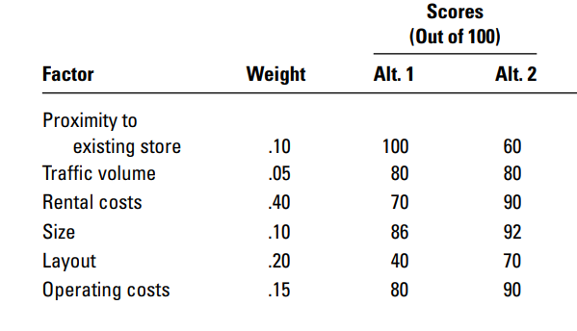
Factor Rating - Example

Slide 23
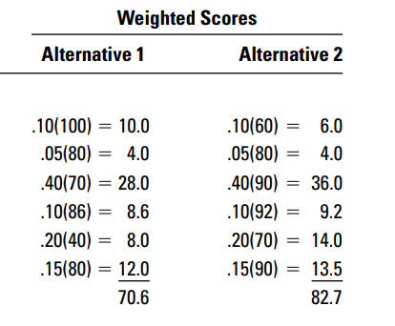
Solution

Slide 24
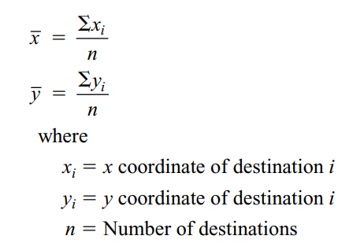
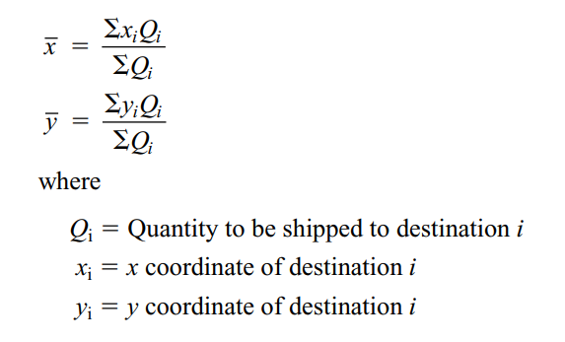
Center of Gravity Method

Slide 25
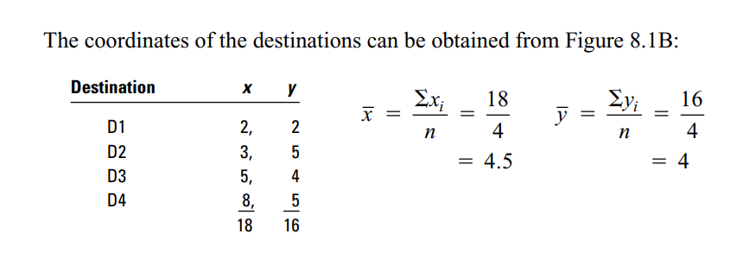
Example 1

Slide 26
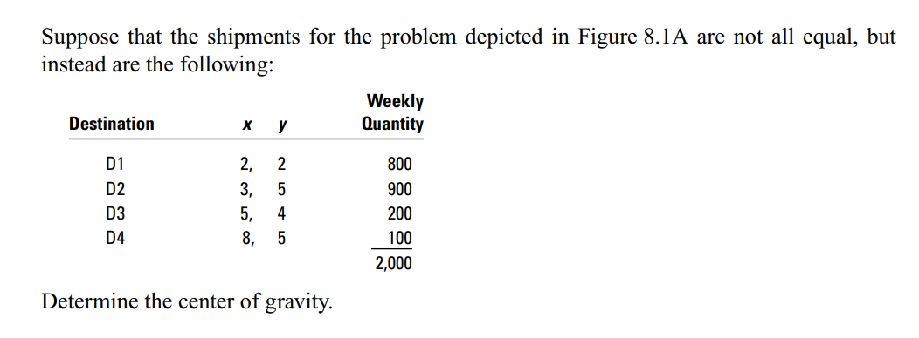
Example 2

Slide 27
